Slide 1
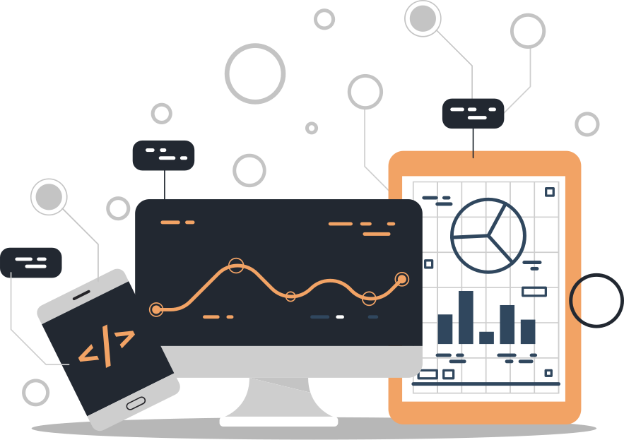
SMART WEATHER MONITORING

Slide 2

TABLE OF CONTENTS
Introduction
Motivation
Background and Existing Projects
System Features
Proposed Methodology
Circuit Diagram
Dashboard
Demo (links)
Components Used
System Limitations

Slide 3




INTRODUCTION
A system designed to monitor environmental parameters such as temperature, humidity, and light intensity.
The system is built using IoT technology, featuring the ESP32 microcontroller, DHT22 and LDR sensors, and a passive buzzer as the actuator.
Data collected by the system is transmitted to the ThingSpeak Cloud via Wi-Fi, where it is visualized on a user-friendly dashboard, accessible through the web.
Provides reliable and accurate data for industries reliant on weather conditions.

Slide 4
MOTIVATION
The impact of climate change has drastically transformed environmental conditions.
There is a critical need for systems that monitor weather conditions effectively.
Swift and accurate weather data is essential for proactive environmental management.
Remote monitoring ensures accessibility and timely information in hard-to-reach areas.

Slide 5
BACKGROUND (Similar Projects for inspiration)
Weather Underground (WU) Personal Weather Stations:
Enables individuals to contribute real-time local weather data using personal weather stations.
Arduino-based Weather Monitoring Systems:
Affordable DIY IoT projects using Arduino and sensors for small-scale weather monitoring.
Smart Cities Weather Stations:
Urban IoT stations integrated with city infrastructure for air quality and weather management.
Davis Vantage Pro2 Weather Stations:
High-precision weather monitoring with advanced sensors and local/online data access.
Netatmo Weather Station:
User-friendly IoT device for indoor and outdoor weather updates via smartphone integration.

Slide 6
1
Real-Time Weather Monitoring
4
SYSTEM FEATURES
Remote access
2
Cloud Integration
5
Low-Power Consumption
3
User-Friendly Interface

Slide 7
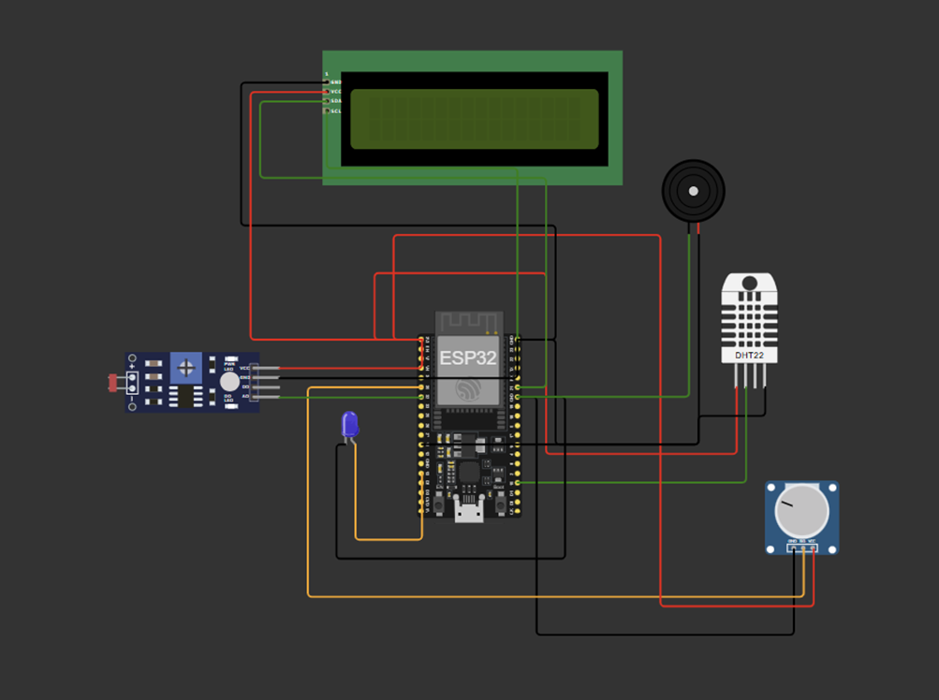
CIRCUIT DIAGRAM

Slide 8
COMPONENTS USED
ESP32 (Microcontroller)
DHT22 (Temperature and Humidity Sensor)
LDR (Light Dependent Resistor)
Buzzer
LED
Potentiometer
LCD (Liquid Crystal Display)

Slide 9
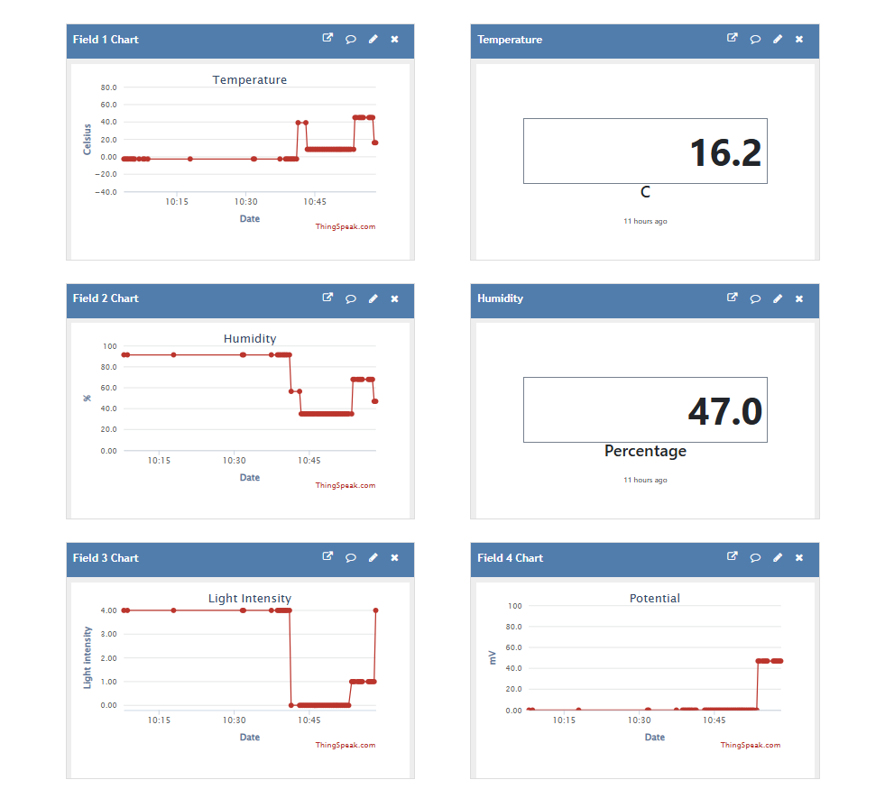
DASHBOARD

Slide 10
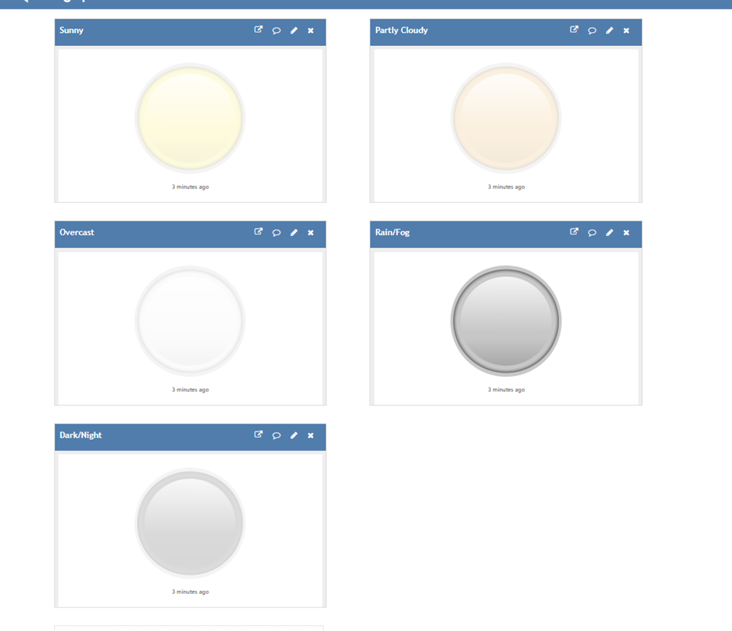
DASHBOARD (Light Indicators)

Slide 11
DEMO LINKS
Wokwi System Simulator (with code): https://wokwi.com/projects/417887757310844929
ThingSpeak Dashboard: https://thingspeak.mathworks.com/channels/2792928

Slide 12

SYSTEM LIMITATIONS
Limited Sensor Range
Dependency on Wi-Fi
Limited Battery Life
Limited Battery Life
No Air Quality Monitoring
No Real-Time Data Analysis

